Slide 1
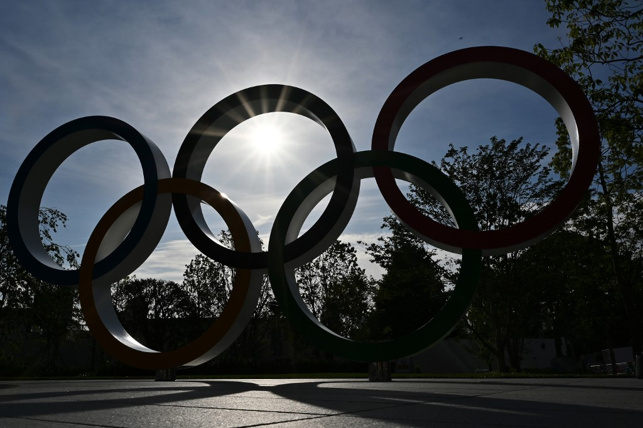
Capstone Project
-Sports analysis
By Vemula Geetha

Slide 2
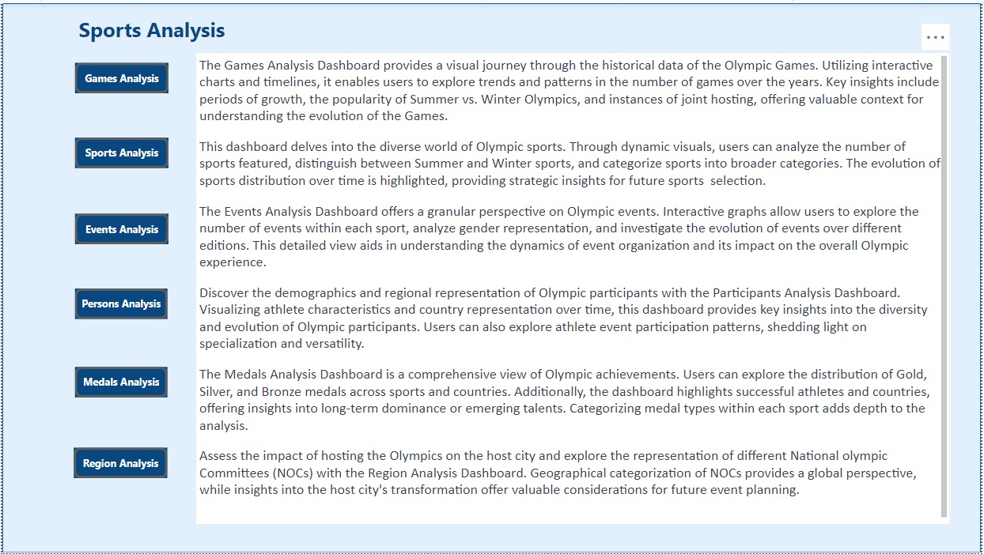

Slide 3
Objective: The primary objective of this analysis is to gain valuable insights into the historical data of the Olympic Games. By exploring various dimensions, including games, sports, events, participants, medals, and regional representation, the analysis aims to uncover trends, patterns, and significant insights from different aspects of the Games. The goal is to provide a comprehensive overview of the Olympics' history and evolution, identifying key factors that have shaped the event over the years. The analysis will also generate recommendations to enhance future Olympics' organization, sports selection, and the representation of diverse regions
Analysis Scope: The scope of the analysis encompasses data from multiple editions of the Olympics, covering both Summer and Winter Games. The analysis will delve into the details of sports, events, cities, and countries involved in the Games. It will explore the evolution of the Olympics since its inception in 1896, considering changes in sports, participation, and regional representation. The interconnected tables, such as Sport, Event, City, Games, NOC Region, Person, and Medal, will be used to conduct a thorough examination of the historical data.
Goal: The main goal is to provide a detailed overview of the Olympics' history, identifying trends and patterns that have emerged over the years. The analysis aims to answer key questions related to the evolution of sports, participant demographics, regional diversity, and medal distribution. By achieving this goal, the analysis will contribute to a better understanding of the factors influencing the success and significance of the Olympic Games.

Slide 4
Insights & Recommendations: The analysis will seek to uncover insights related to changes in the popularity of sports, shifts in regional dominance, and the impact of socio-cultural factors on participant demographics. Insights will be drawn from trends in medal distribution, participation rates, and the overall growth of the Olympics as a global sporting event. Based on these insights, recommendations will be generated to enhance future Olympics' organization, sports selection, and representation of diverse regions. These recommendations may include adjustments to the event format, strategic decisions in selecting sports, and measures to promote inclusivity and diversity.
Report Presentation: The final deliverable will be a comprehensive report and presentation showcasing the findings and historical significance of the Olympic Games. The report will include detailed visualizations, charts, and graphs to illustrate key trends and patterns. It will also provide a narrative that explains the evolution of the Olympics over time. The presentation will be designed to effectively communicate the insights and recommendations to a diverse audience, including stakeholders involved in organizing future Olympic Games, sports enthusiasts, and policymakers.

Slide 5
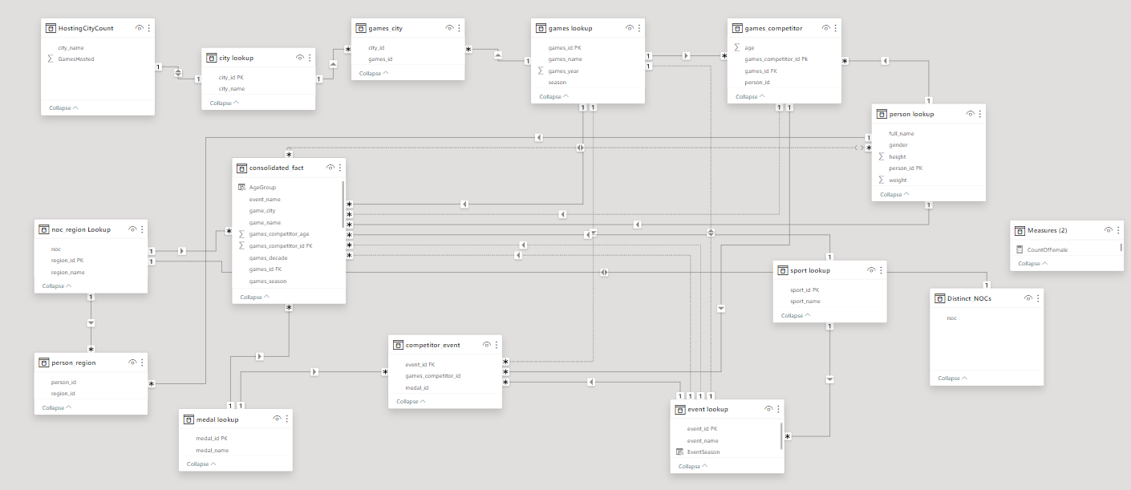
ER Diagram

Slide 6
POWER BI PROBLEM STATEMENTS

Slide 7
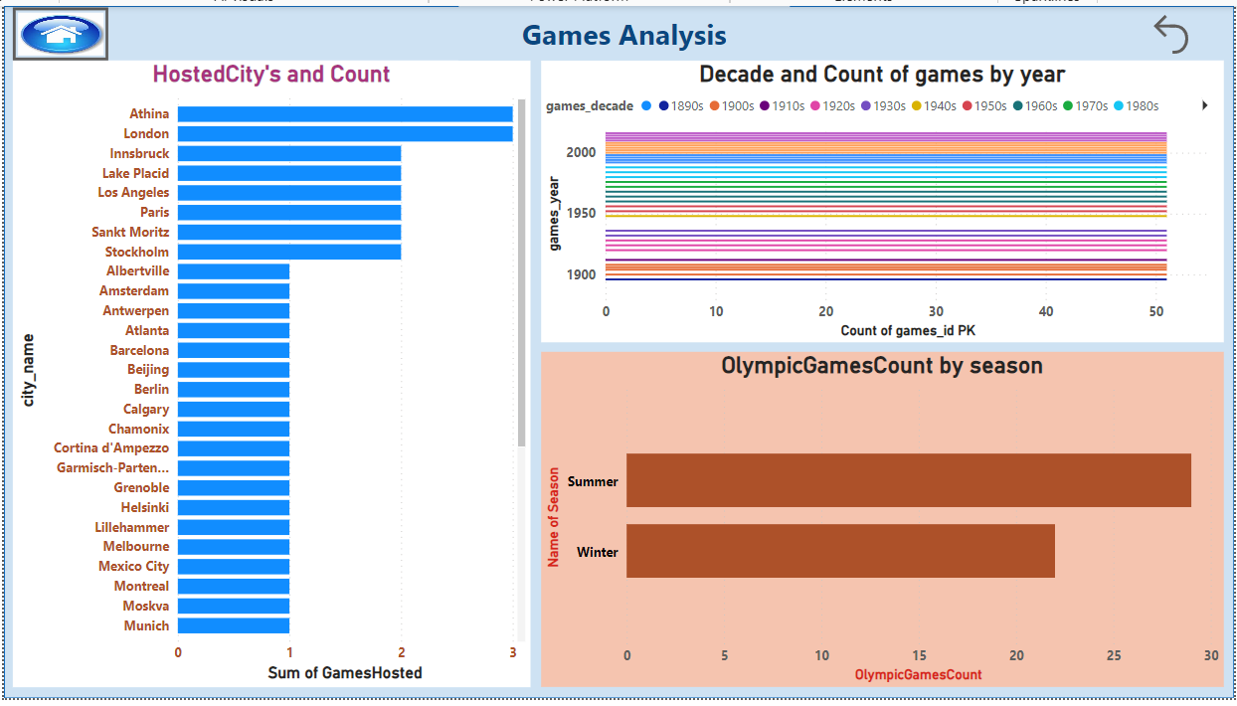

Slide 8
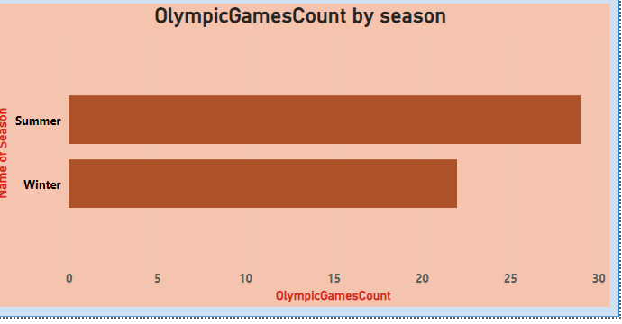
How many Olympic Games have been held in each season (Summer vs. Winter)?
It seems that there have been a total of 29 Summer Olympic Games and 22 Winter Olympic Games. The x-axis represents the Olympics count, with 29 for Summer and 22 for Winter, while the y-axis represents the number of seasons. This indicates a higher frequency of Summer Olympic Games compared to Winter Olympic Games, highlighting the longstanding tradition and popularity of the Summer Olympics.

Slide 9
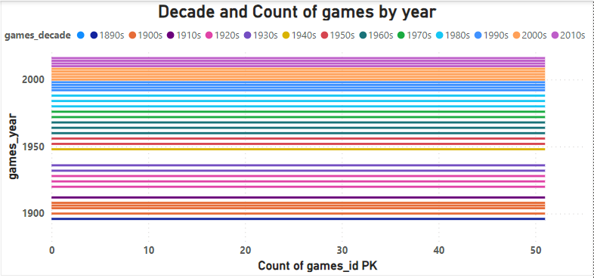
What is the distribution of games across different decades?
The distribution of games across different decades reveals a consistent pattern, with each decade contributing approximately 51 games. This balanced distribution suggests a steady and sustained production of games over time, highlighting the enduring popularity and growth of the gaming industry. The consistent count of 51 games count across various decades implies a stable and diverse landscape of gaming content, reflecting the industry's ability to adapt and innovate across different eras.

Slide 10
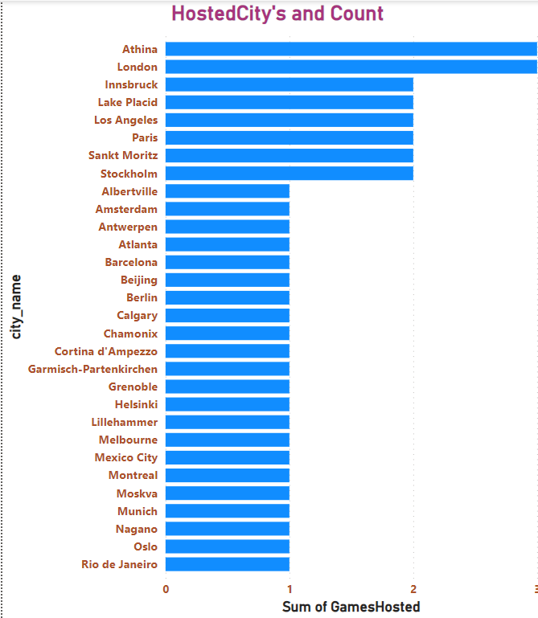
Which cities have hosted the most Olympic Games?
The cities that have hosted the most Olympic Games are Athens, London, each hosting three Olympic Games. These cities have played a significant role in the history of the Olympic movement, showcasing their ability to organize and host the prestigious international event multiple times. The sum of games hosted is represented on the x-axis, while the city names are depicted on the y-axis, highlighting the historical significance of these particular host cities in the Olympic Games' rich legacy.

Slide 11
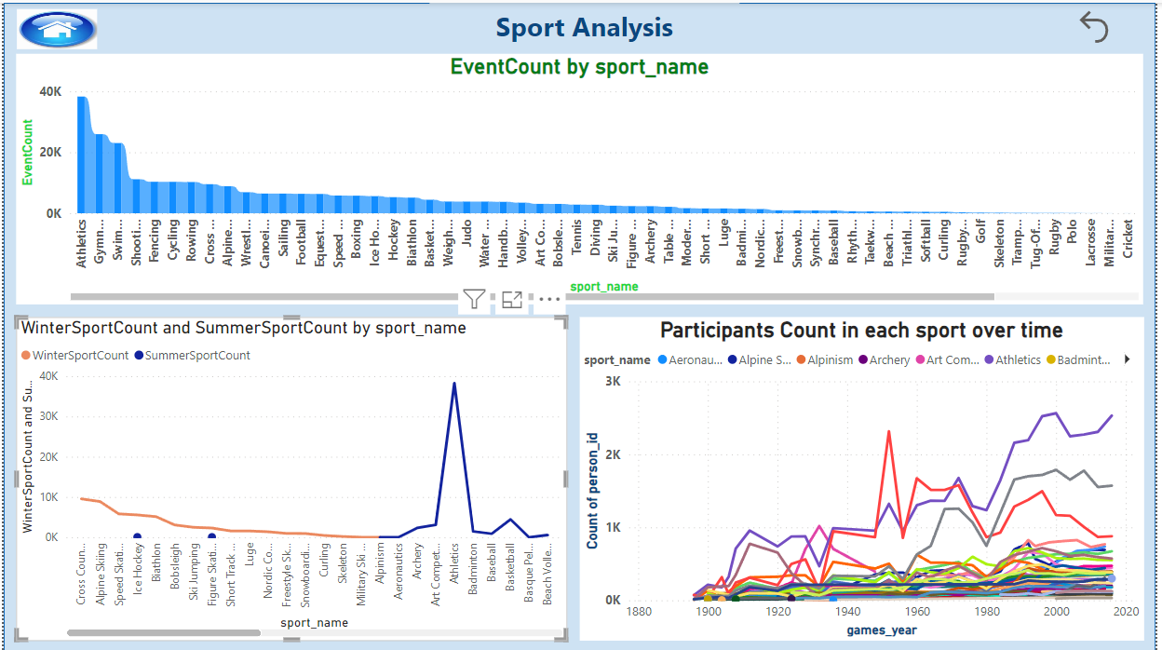

Slide 12
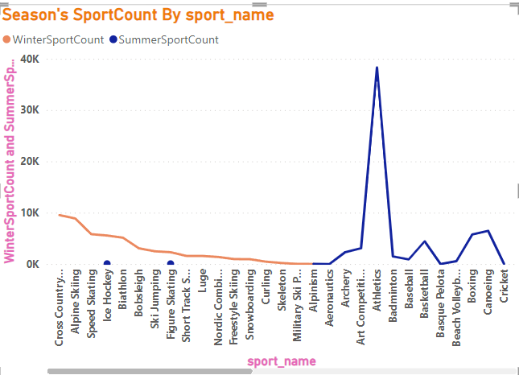
What is the distribution of sports between Summer and Winter Olympics?
The distribution of sports between Summer and Winter Olympics is uneven, with the Summer Games featuring a larger variety and number of sports compared to the Winter Games. The Summer Olympics typically include sports such as athletics, gymnastics, swimming, and team sports, contributing to a total count of 218,259 events. In contrast, the Winter Olympics focus on cold-weather sports like skiing, snowboarding, and ice skating, with a total event count of 49,892. This asymmetry reflects the diverse nature of sports played in different seasons and caters to the interests and climate preferences of a global audience.

Slide 13
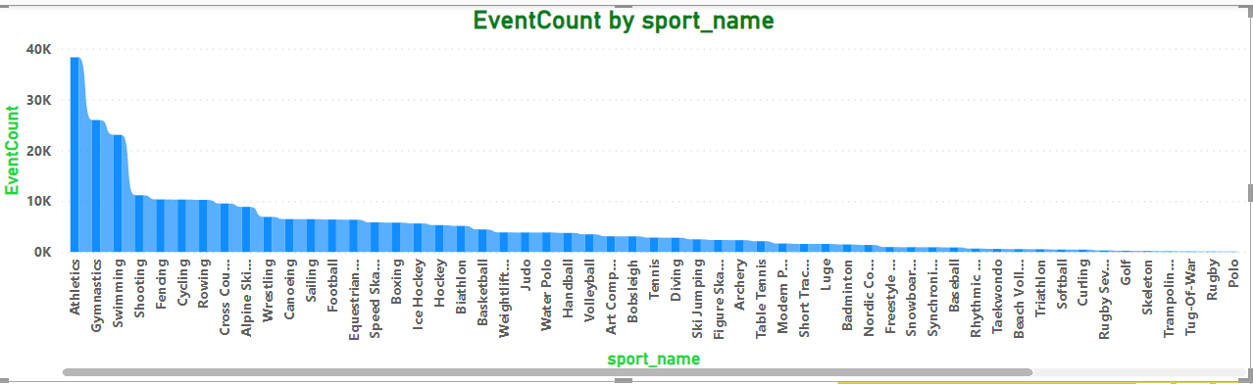
Which sports have the highest number of events in the Olympics?
The Olympics feature a diverse array of sports, with athletics having the highest number of events at 38,301, showcasing its broad spectrum of track and field competitions. Although aeronautics is represented with only one event, the total count of 268,154 events underscores the extensive variety of sports that contribute to the global celebration of athleticism in the Olympic Games. This diversity reflects the Games' commitment to inclusivity and the recognition of a wide range of physical and mental abilities.

Slide 14
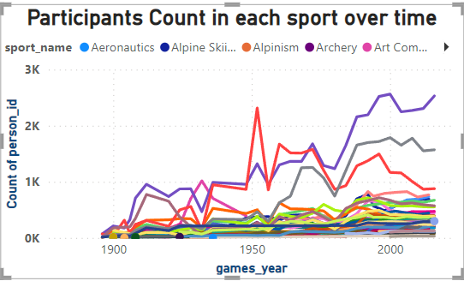
How has the participation in each sport evolved over time?
It appears that there has been a marginal decline in the number of participants in athletics over the years, with 2564 in 2000, 2522 in 1996, and 2531 in 2016. However, the overall count of 268151 events suggests a significant breadth of participation across various sports. The unique case of aeronautics with a single event in 1996 highlights the diversity in sports, and the evolving landscape of participation underscores the ongoing dynamism within the sporting world.

Slide 15
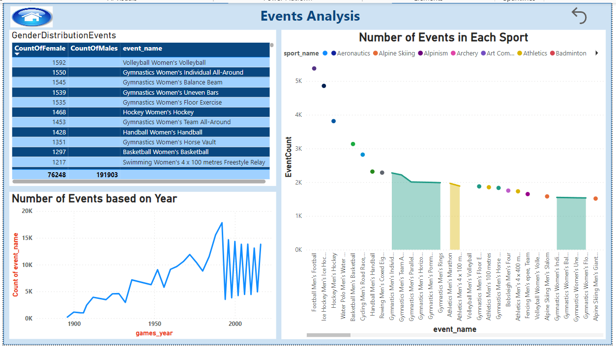

Slide 16
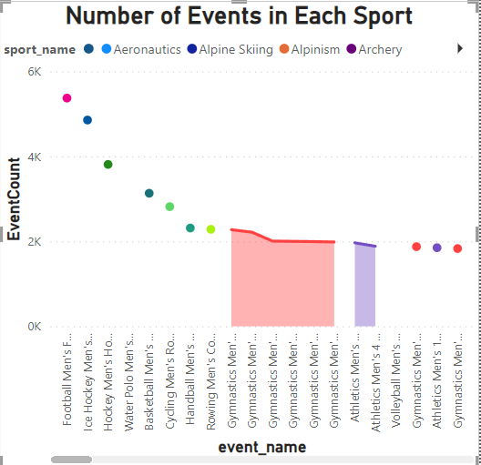
How many events are there in each sport?
It seems like you provided information about the total number of events (268154) and highest count sport is football men's events count (5375).In this I mentioned number of evnt’s for each sport

Slide 17
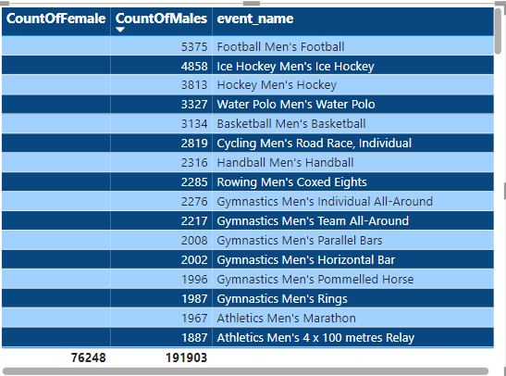
What is the distribution of events by gender (Men, Women, Mixed)?
Based on the provided information, the distribution of events by gender shows 76,248 females and 191,903 males, indicating a significant imbalance with a higher representation of males. This gender disparity may warrant further investigation and consideration for promoting inclusivity in event participation.

Slide 18
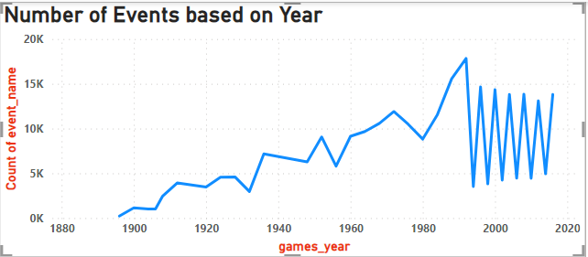
How has the number of events changed over time?
The number of events has shown a significant increase over time, with a peak of 17,831 events in 1992 and a minimum of 216 events in 1896. This trend suggests a notable expansion in the occurrence of events over the years, reflecting the evolving nature of human activities and global dynamics . After 1992 the count becomes stable over years

Slide 19
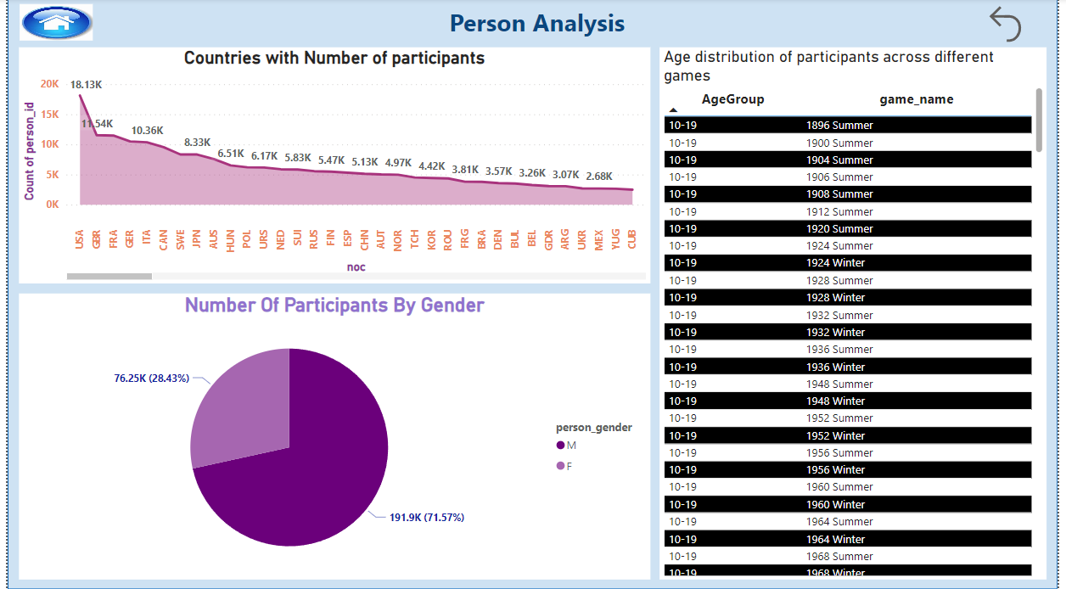

Slide 20
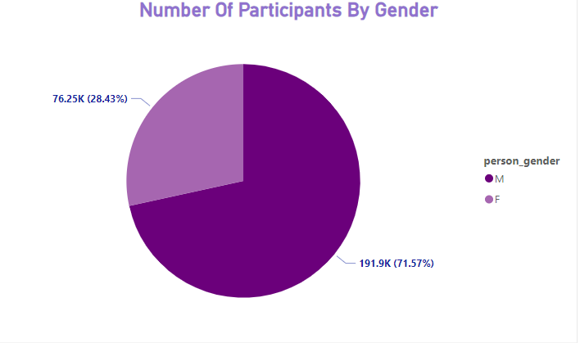
What is the distribution of participants by gender?
The distribution of participants by gender indicates that there are significantly more males (191,903) than females (76,248). This imbalance may have implications for the representativeness and diversity of the participant pool, potentially influencing the generalizability of study findings.

Slide 21
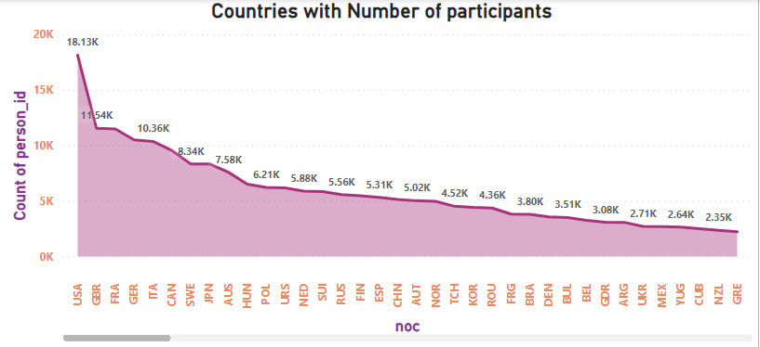
Which countries have the highest number of participants in the Olympics?
The United States has consistently demonstrated a strong presence in the Olympics with a remarkable participation count of 18,217 athletes. On the contrary, some National Olympic Committees (NOCs), such as those representing North Borneo (NBO) and Norfolk Island (NFL), have notably lower participation rates, each with only two athletes in comparison.

Slide 22
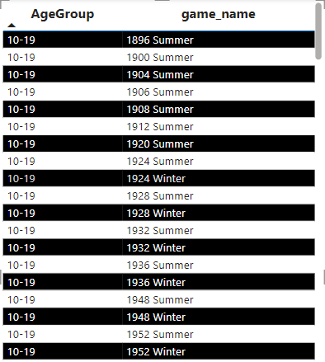
How does the age distribution of participants vary across different games?
The age distribution of participants in different games varies significantly, reflecting the diverse demographics of the gaming community. While some games may appeal more to younger audiences with fast-paced and visually stimulating content, others cater to a broader age range with strategic or narrative-driven gameplay. Understanding these variations is crucial for game developers and marketers to tailor their products effectively and engage with a diverse player base.

Slide 23
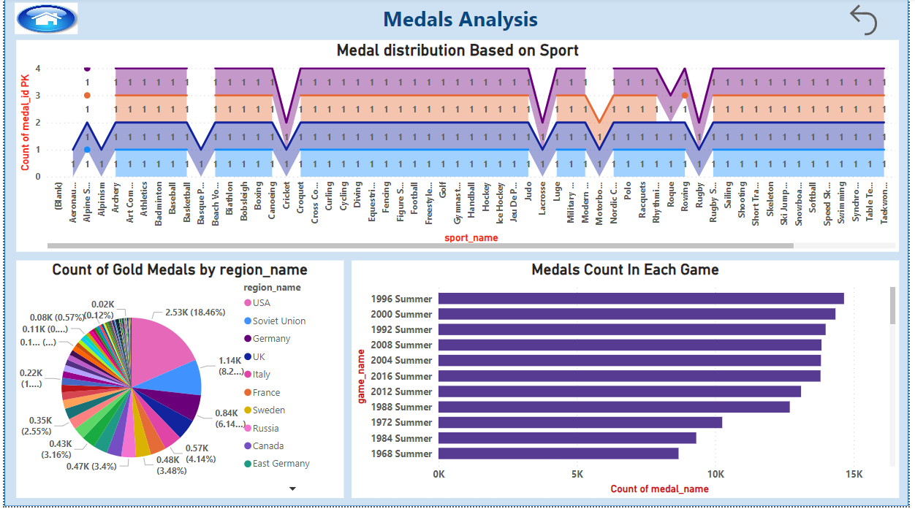

Slide 24
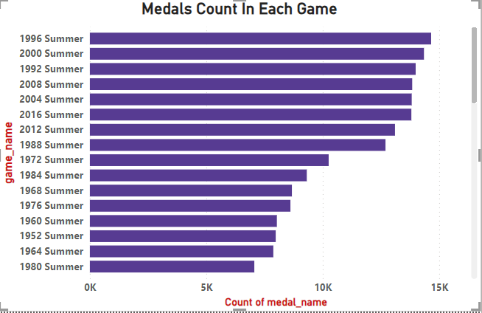
How many medals have been awarded in each Olympics?
The number of medals awarded in each Olympics has varied significantly over the years. The highest count was in the 1996 Summer Olympics with 14,655 medals, followed closely by the 2000 Summer Olympics with 14,347 medals. The lowest count observed was in the 1896 Summer Olympics with 219 medals, and the 1932 Winter Olympics had the lowest count for a Winter Games with 325 medals. These fluctuations highlight the evolving nature and growth of the Olympic Games over time.

Slide 25
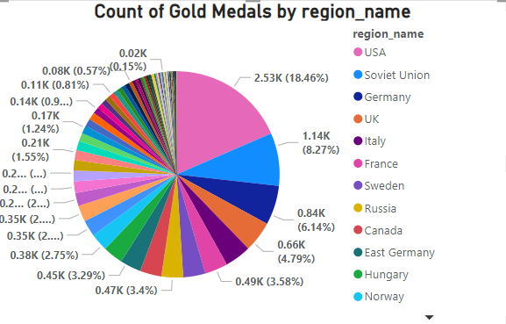
Which countries have the highest number of gold medals?
The United States leads with the highest number of gold medals, totaling 2533, followed by the former Soviet Union with 1135. In contrast, several countries, including Albania, Bahrain, Burundi, Costa Rica, and others, have achieved the least number of gold medals, each having only one or fewer, reflecting a significant disparity in Olympic success among nations.

Slide 26
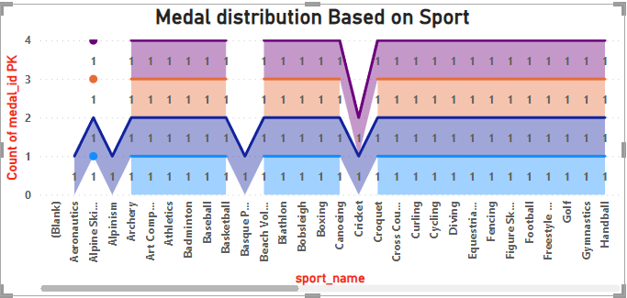
How does the medal distribution vary across different sports?
The distribution of medals across different sports varies based on factors such as the number of events, participating nations, and the nature of the sport itself. In general, sports with a higher number of events, such as athletics or swimming, tend to have a more diversified distribution of medals, while sports with fewer events may see a concentration of medals among a smaller group of nations or athletes.

Slide 27
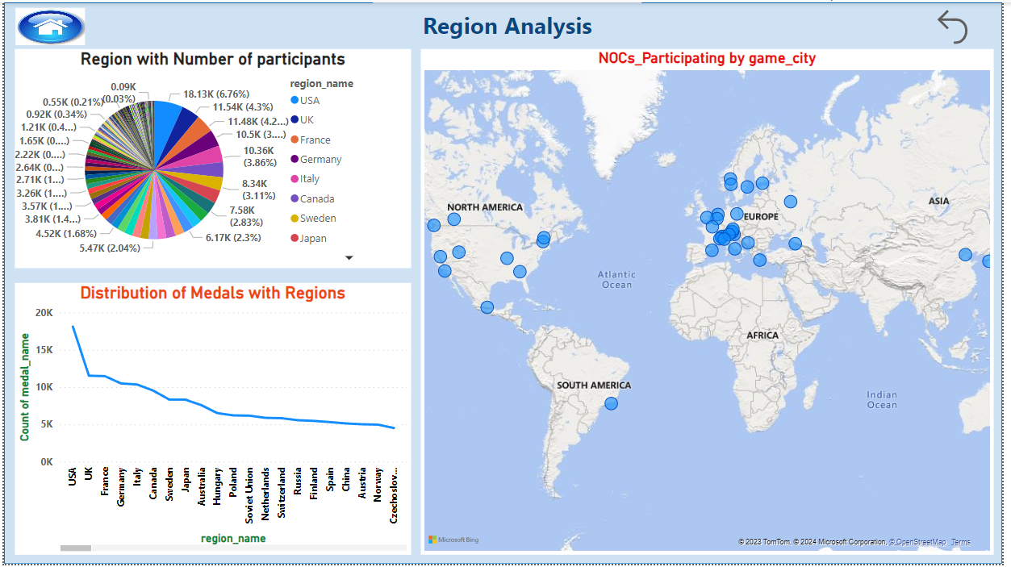

Slide 28
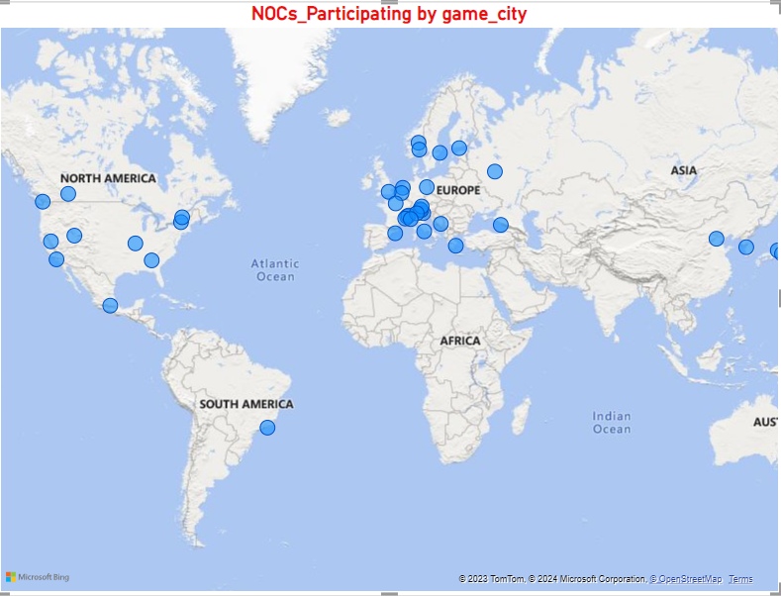
How many regions or NOCs participate in each Olympic Games?
The number of National Olympic Committees (NOCs) participating in each Olympic Games can vary, as it depends on factors such as geopolitical changes and the decisions of the International Olympic Committee (IOC). Generally, the number has been increasing over the years, with the 2016 Tokyo Olympics having over 231 NOCs. In conclusion, the participation of NOCs in the Olympic Games is dynamic and subject to change, reflecting the global nature of the event and the evolving landscape of international sports.

Slide 29
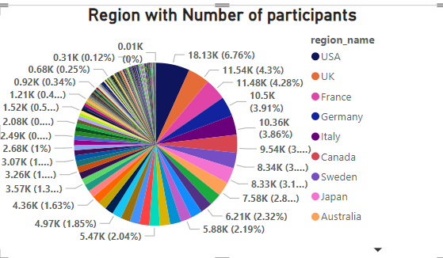
Which regions have the highest number of participants in the Olympics?
The USA and the UK consistently rank among the regions with the highest number of participants in the Olympics, reflecting their strong sporting traditions and large athlete pools. In contrast, regions with relatively smaller populations, such as Newfoundland in Canada and North Borneo, typically contribute fewer participants to the Olympic Games.

Slide 30
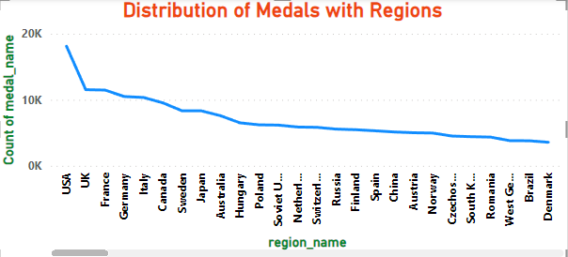
What is the distribution of medals among different regions?
The distribution of medals among different regions varies significantly, with the USA and the UK leading with the highest counts, while Newfoundland, North Borneo, and Crete have comparatively lower counts. This highlights a notable disparity in medal achievements, with certain regions like Newfoundland, North Borneo, and Crete having received fewer medals in comparison to the more prominent performances of the USA and the UK.

Slide 31
EDA (Exploratory Data Analysis) PROBLEM STATEMENTS

Slide 32
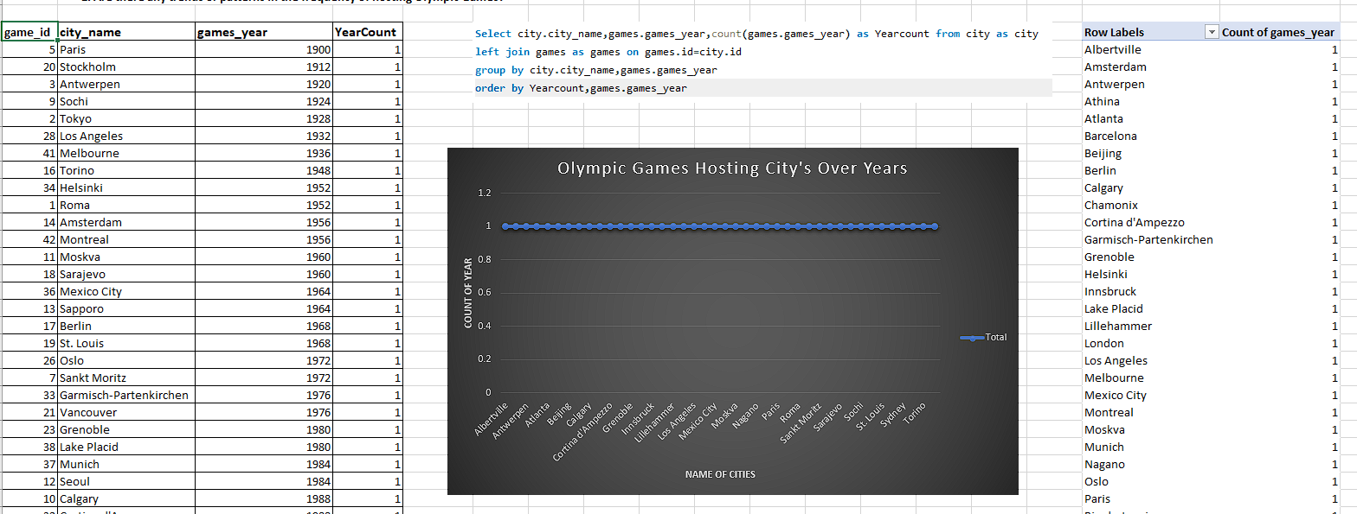
Are there any trends or patterns in the frequency of hosting Olympic Games?
Conclusion: Here Each city has the same year count ,that implies each city has hosted the Olympic Games an equal number of times . My analysis conclusion would be that there is no trend or pattern in terms of the frequency of hosting Olympic Games across different cities . They are uniformly maintaining the hosting distribution in city .

Slide 33
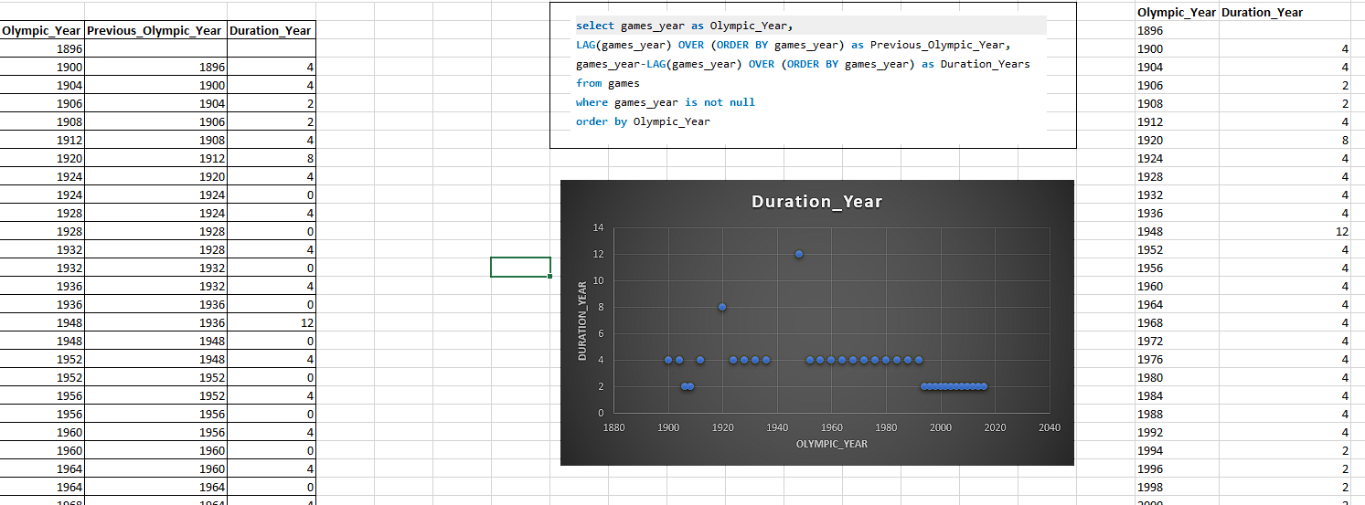
How has the duration of Olympic Games changed over time?
Conclusion: The Olympic games are started at 1896,initially it maintain 4 years duration and at middle it changes and again maintain the duration as 4 years and at finally they are conducting the games for every 2 years as per the given data.

Slide 34
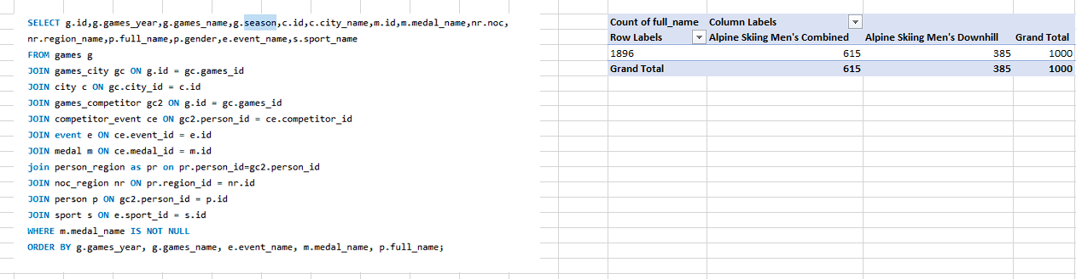
Are there any notable events or occurrences associated with specific Olympic Games?
CONCLUSION: Based on the out put it provides a breakdown of medal counts for specific events (Alpine Skiing Men's Combined and Alpine Skiing Men's Downhill) across Olympic Games years. The table suggests that Alpine Skiing Men's Combined had 615 medals, while Alpine Skiing Men's Downhill had 385 medals, contributing to a total of 1000 medals across all years. This breakdown can be further analyzed to identify notable trends or occurrences, such as years with particularly high or low medal counts in these events.

Slide 35
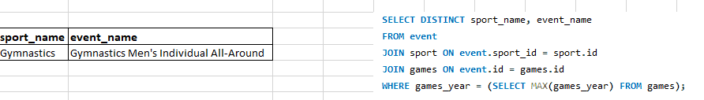
Are there any emerging sports that have been recently added to the Olympics?
Conclusion : Based on the given Olympic Games data set, Gymnastics, specifically the event "Gymnastics Men's Individual All-Around," appears to be a sport that may have been recently added to the Olympics

Slide 36
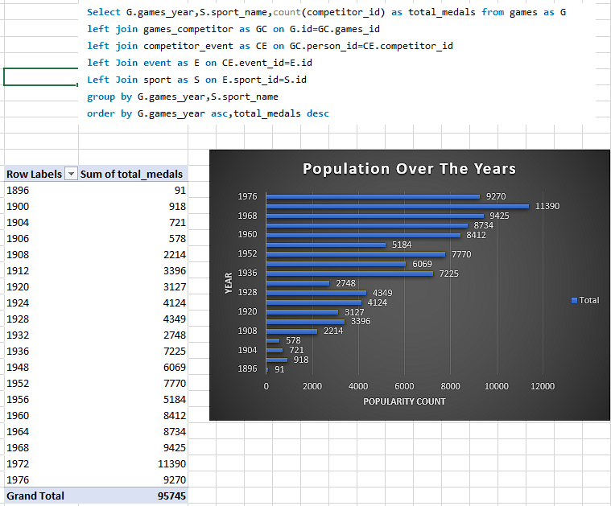
How has the popularity of certain sports changed over the years?
Conclusion :
The Olympic Games have been evolved significantly since 1896, witnessing a dramatic increase in the number of sports and events and the popularity. Over the years, athletics , gymnastics, and swimming have consistently remained popular and dominant sports.

Slide 37
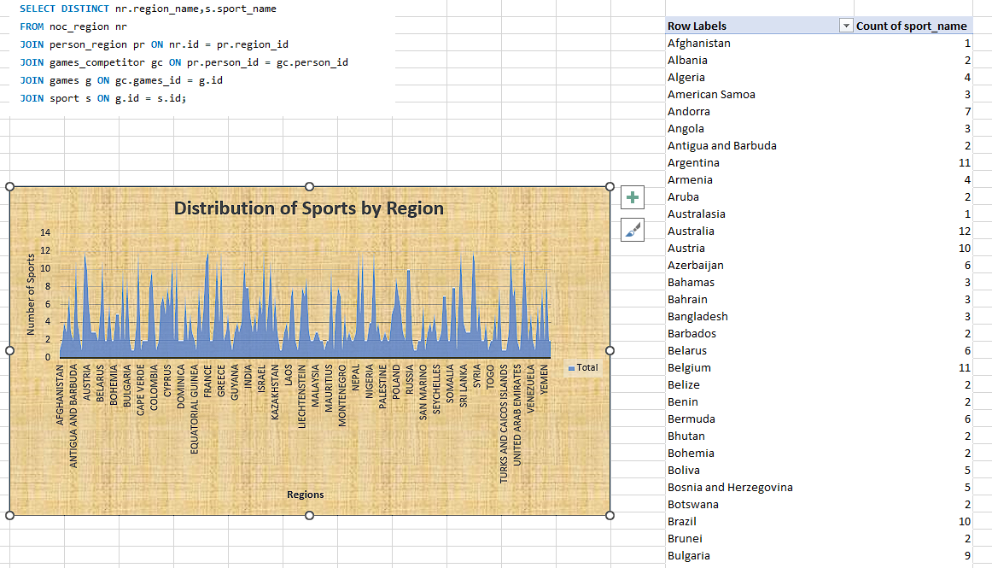
Are there any sports that are specific to a particular region or culture?
Conclusion:
Based on the output appears to list the combination of countries and sports, indicating the participation of each country in specific sports. However, it includes entries like "Aeronautics," "Alpine Skiing," "Alpinism," "Archery," "Art Competitions," "Athletics," "Badminton," "Baseball," "Basketball," "Basque Pelota," "Beach Volleyball," and "Biathlon" with their corresponding countries. The dataset spans a wide range of sports and countries, illustrating the diversity of athletic participation across the globe.

Slide 38
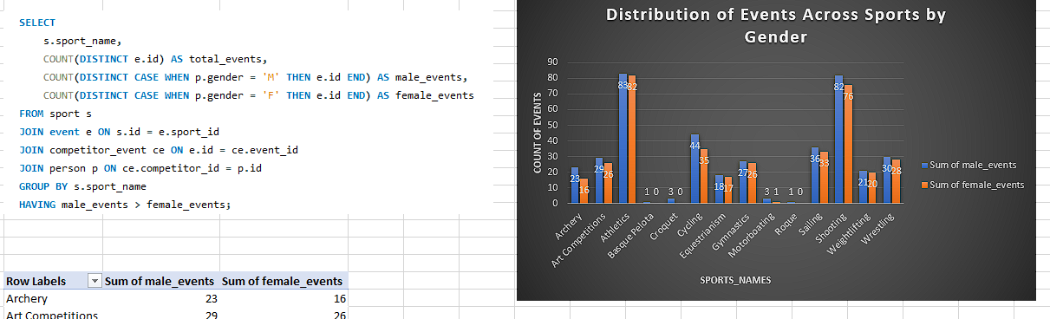
Are there any sports that have a higher number of events for one gender compared to others?
Conclusion:Based on the output, it appears that in several sports, there is a higher number of events for males compared to females. Notably, Athletics, Shooting, and Cycling exhibit this pattern with all events having male participation exceeding female participation.

Slide 39
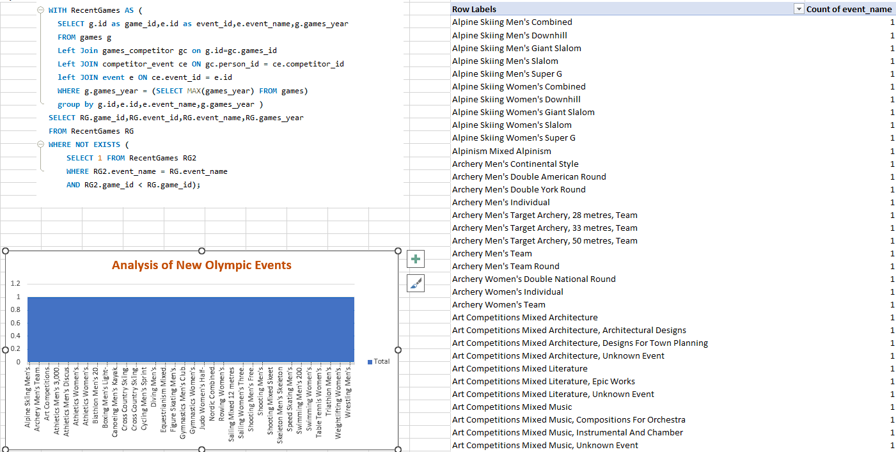
Are there any new events that have been introduced in recent editions of the Olympics?
Conclusion :
In recent editions of the Olympics, several new events have been introduced to enhance the diversity and appeal of the Games. These additions aim to attract a broader audience and showcase emerging sports. The inclusion of these new events reflects the Olympic Committee's commitment to adapting to evolving interests and promoting inclusivity in the world of sports.

Slide 40
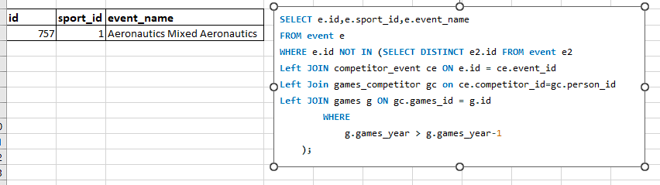
Are there any events that have been discontinued or removed from the Olympics?
Conclusion: Based on the provided output displays an event with an ID of 757, a sport ID of 1, and the event name "Aeronautics Mixed Aeronautics." However, the absence of additional columns, such as a status indicator or information about historical participation, makes it challenging to definitively conclude whether this event has been discontinued or removed from the Olympics.

Slide 41
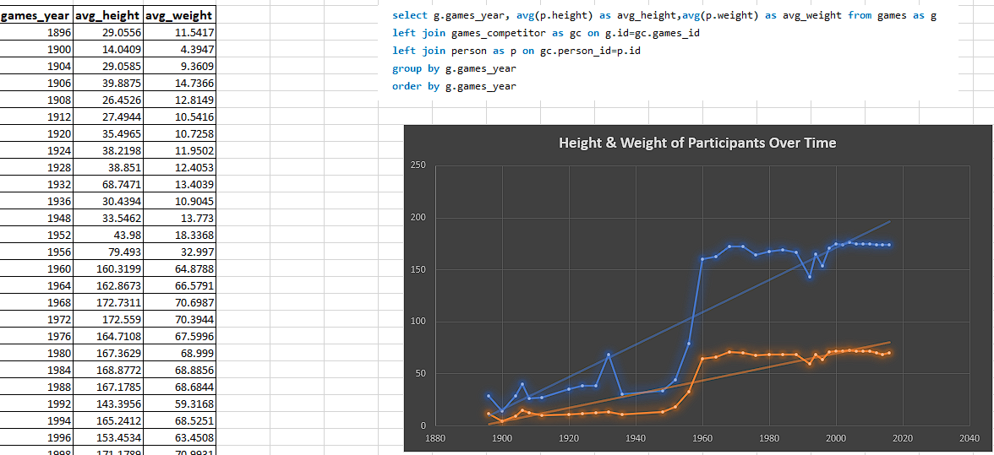
Are there any notable trends in the height and weight of participants over time?
Conclusion: The output presents a comprehensive overview of the average height and weight of participants across different Olympic Games years. Analyzing the trends, it appears that there is a noticeable increase in both height and weight over the years, with significant spikes in the 1960s and 1970s. However, since the 1980s, the values have remained relatively stable, indicating a plateau in the average height and weight of Olympic participants.

Slide 42
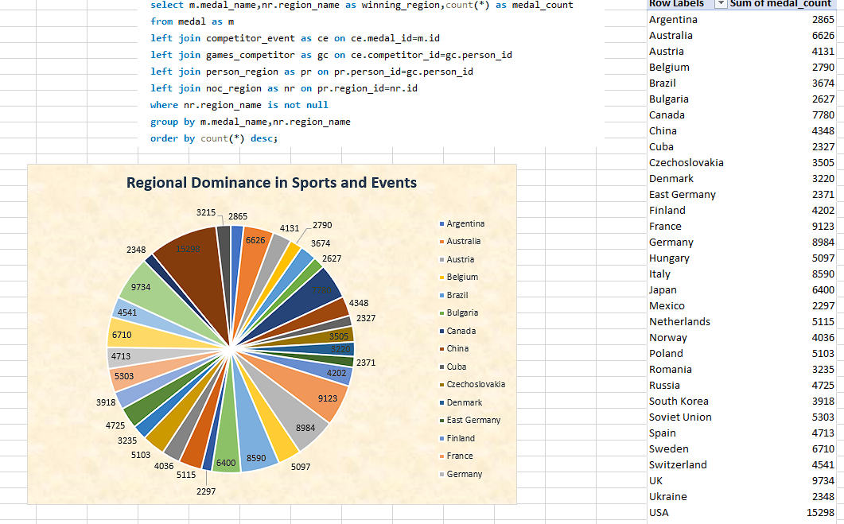
Are there any dominant countries or regions in specific sports or events?
Conclusion : By examining the medal counts, I observe that the USA, UK, France, Germany, and Italy consistently rank among the top nations with the highest medal counts. This suggests a pattern of dominance for these countries across a broad range of sports and events. The conclusion is that these nations have historically excelled in the Olympic Games, showcasing their prowess and competitiveness across diverse sporting disciplines.

Slide 43
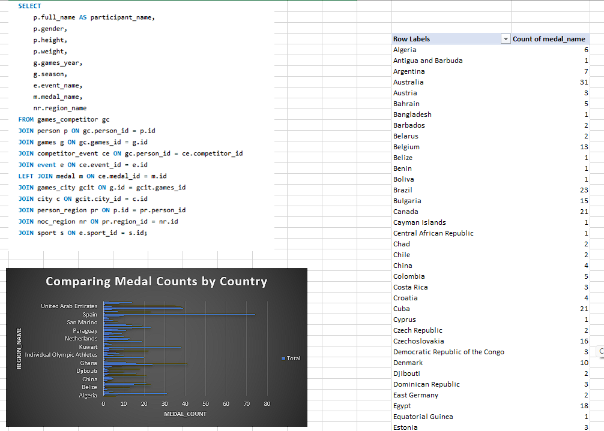
What factors contribute to the success or performance of participants from different countries?
Conclusion: Based on the output it provides a summary of participant details, including their name, gender, height, weight, games year, season, event name, medal name, and region name. To analyze the factors contributing to the success or performance of participants from different countries, one could explore correlations between medal achievements and variables such as height, weight, or gender. Additionally, examining patterns across different games years and regions may offer insights into the influence of these factors on participants' success in various events.

Slide 44
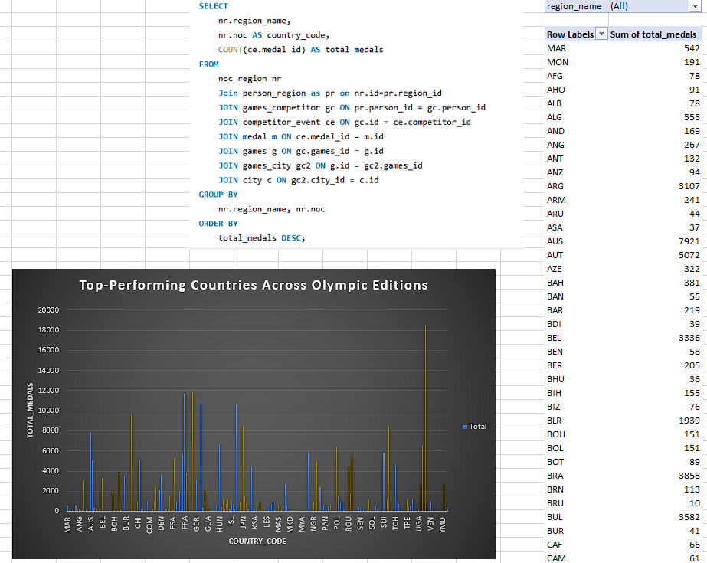
Are there any countries that consistently perform well in multiple Olympic editions?
Conclusion:
Based on the output of total medals won by different countries in various Olympic editions, it appears that countries such as the USA, the UK, France, Germany, and Italy consistently perform well across multiple editions of the Olympic Games. These nations consistently rank among the top medal-winning countries, indicating a sustained level of athletic success and competitiveness. The data suggests a pattern of excellence for these countries over time, showcasing their prowess in various Olympic events.

Slide 45
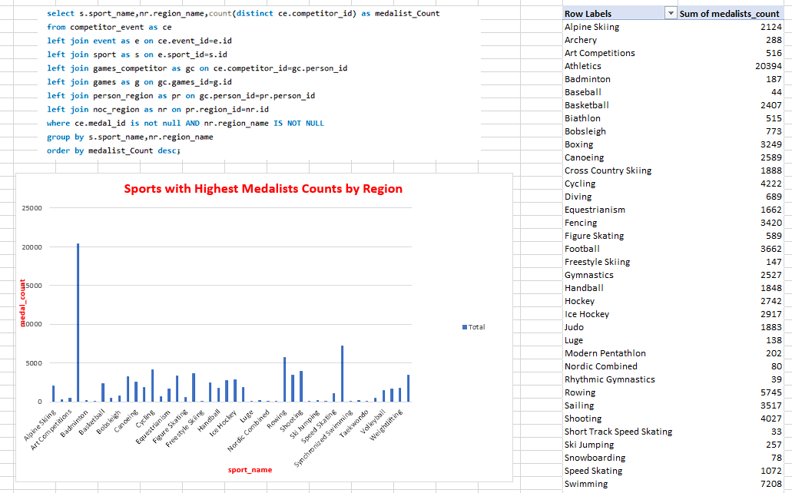
Are there any sports or events that have a higher number of medalists from a specific region?
Conclusion: Based on the output presents the total number of medalists for various countries in Olympic history. Notably, countries such as the United States, China, and Russia have consistently garnered significant medal counts, with the United States leading with 4367 medalists. Traditional sporting powerhouses like Russia (combined with the Soviet Union and East Germany) and China also exhibit substantial medal counts. Additionally, countries like Australia, Canada, and several European nations have made substantial contributions to the overall tally, reflecting their historical success in Olympic competitions.

Slide 46
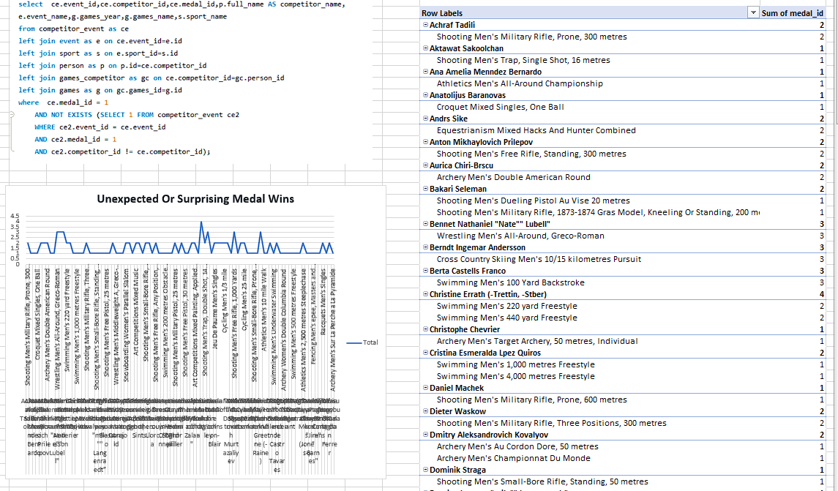
What are some notable instances of unexpected or surprising medal wins?
Conclusion : Based on the provided data showcasing unexpected or surprising medal wins, it's evident that certain competitors achieved remarkable success across multiple Olympic Games and diverse sporting events. Notable instances include Berndt Ingemar Andersson's consistent gold medals in Cross Country Skiing over several Olympics and Berta Castells Franco's unexpected victories in Swimming across different editions.

Slide 47
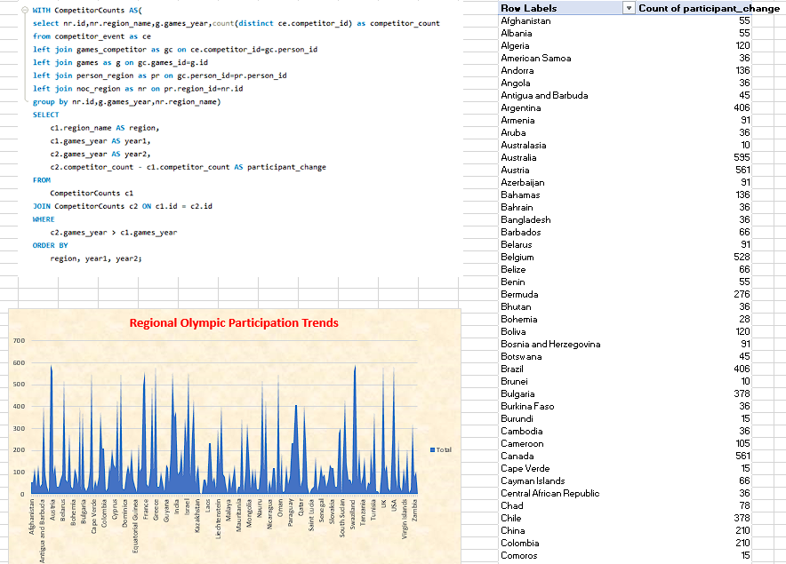
Are there any regions that have experienced significant growth or decline in Olympic participation?
Conclusion: Based on the output one noticeable trend is the substantial growth in participation for countries like China, India, and South Korea. These nations have seen a notable increase in the number of participants over the years. Conversely, some regions, such as the Unified Team, East Germany, and Yugoslavia, have experienced a decline, potentially due to geopolitical changes impacting the composition of participating nations.

Slide 48
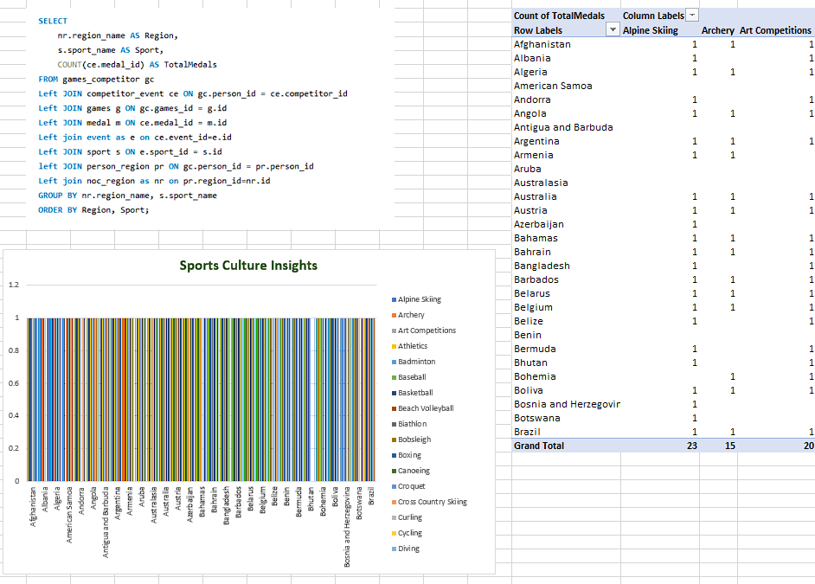
How do cultural or geographical factors influence the performance of regions in specific sports?
Conclusion: Analyzing the data across various sports, it is evident that different regions exhibit diverse levels of success and participation. Cultural and geographical factors likely play a significant role in shaping these outcomes. Some regions, like the United States and Australia, consistently excel across a broad spectrum of sports, possibly influenced by a strong sports culture and robust infrastructure. Meanwhile, variations in performance among regions like Afghanistan or Bhutan may be attributed to factors such as cultural emphasis, resource availability, and local sporting traditions. This dataset underscores the importance of considering cultural and geographical contexts when exploring the dynamics of sports performance across diverse regions.

Slide 49
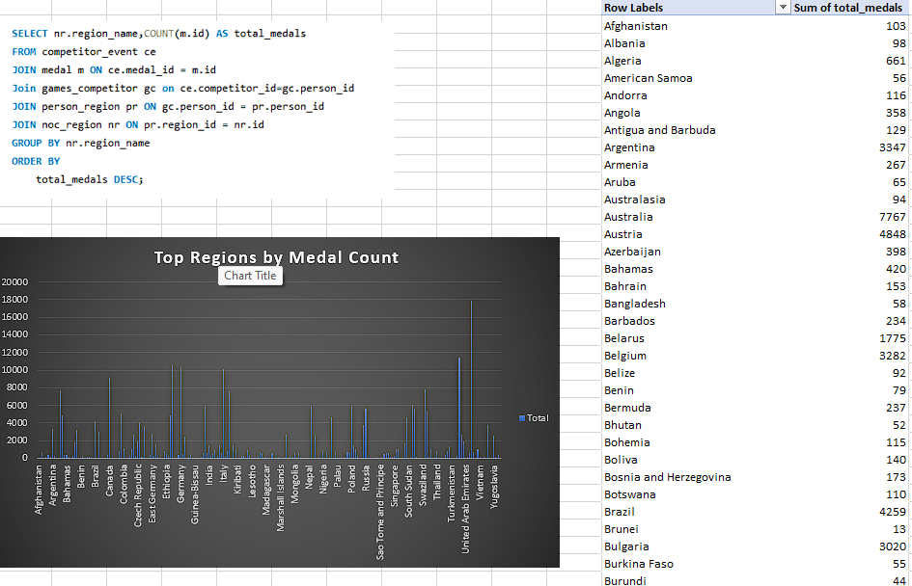
Are there any regions that have had a notable impact on the overall medal tally?
Conclusion: Based on the data it reveals that traditional sporting powerhouses such as the USA, UK, France, Germany, and Italy have consistently dominated the overall medal tally, with the USA leading significantly with 17,873 total medals. Notable contributions also come from countries like China, Russia, and Australia. Interestingly, the dataset illustrates a broad representation of regions across the globe, emphasizing the inclusive and diverse nature of Olympic competition. While the top-ranking regions have a substantial impact, the distribution of medals among a wide range of nations underscores the global and inclusive spirit of the Olympic Games.

Slide 50
Thank You

